Slide 1
Humanizing AI
The Patient's Influence in Reducing Bias in Women's Health
Tia Pope

Slide 2
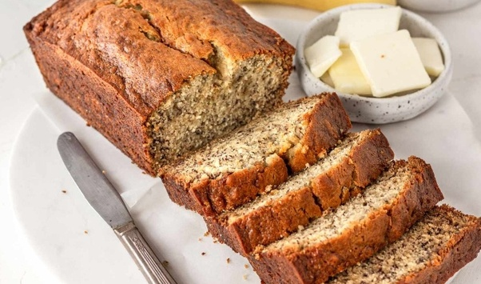
Grandma’s Recipes

Slide 3
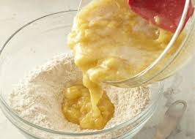

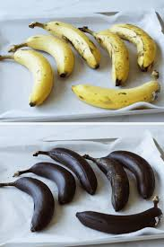
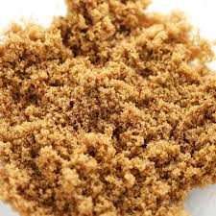


Slide 4

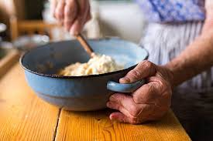


Slide 5
Never.
No one will ever be exactly like nana.
Neither will your models.

Slide 6
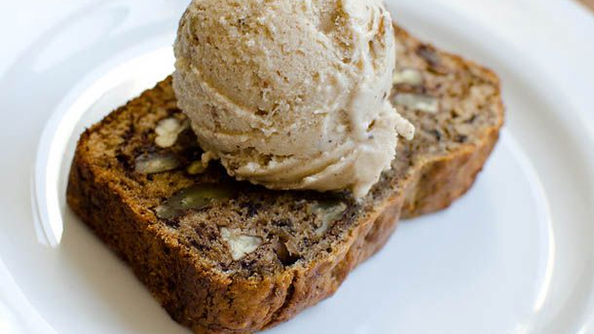
But you can get close.

Slide 7
Part 1: Qualifications

Slide 8
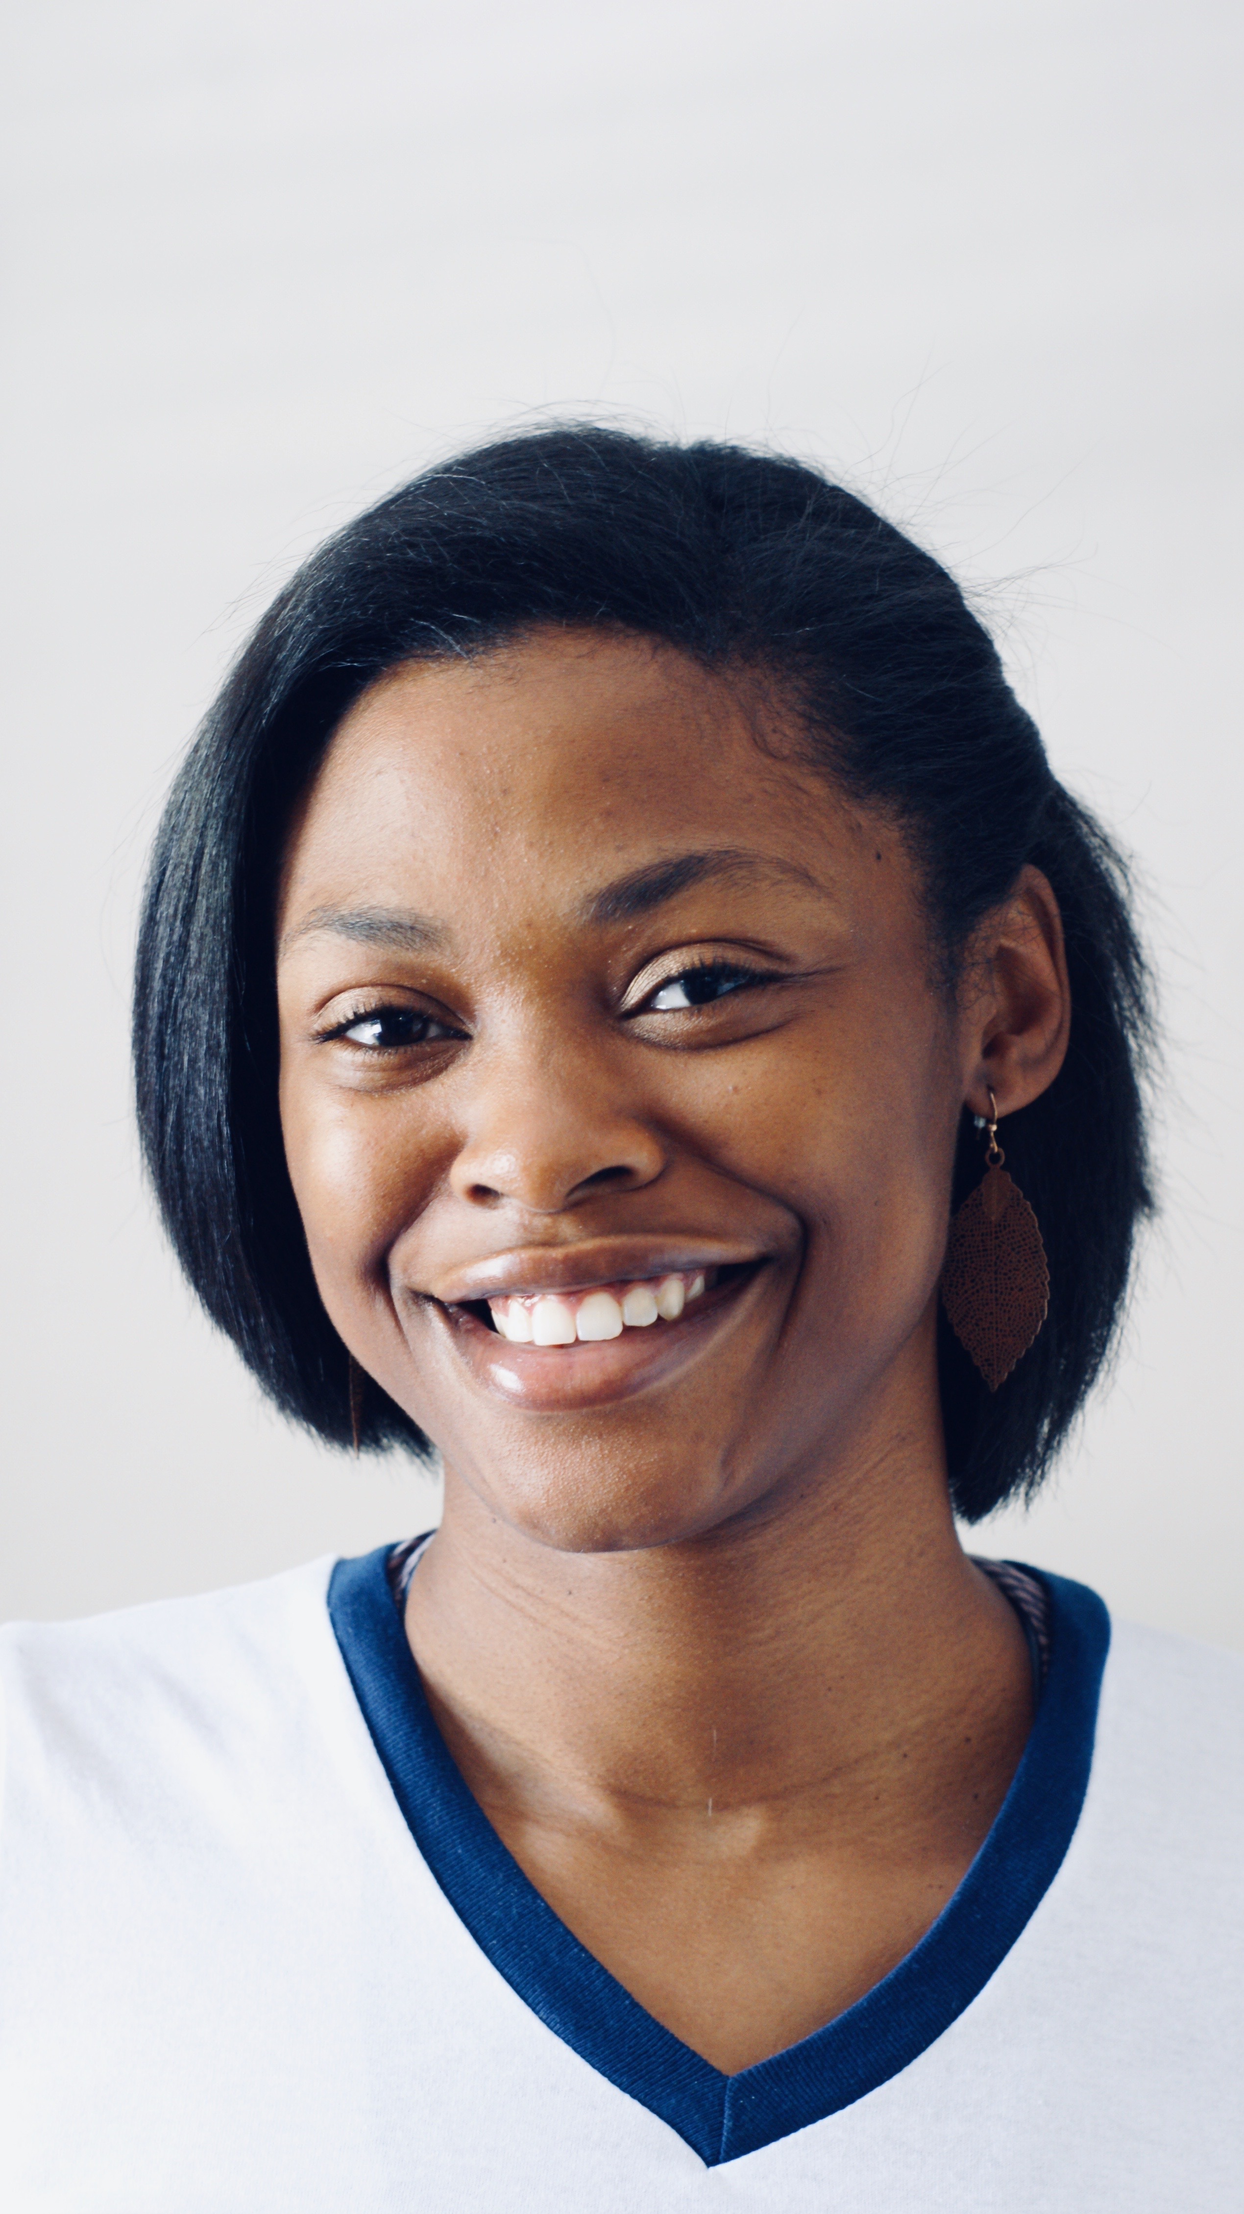
Who Am I?
Rising 3rd Year PhD Candidate
Applied Science & Technology – AI
  Intersection of Cyber + AI + BioTech
North Carolina Agricultural and Technical State University (NCAT)
Knowledge spans many different subjects
Ex-MIT (sorta), Ex-Cisco, Ex-Georgia Tech, Ex-CNN, Ex-IP, Ex-Shaw

Slide 9
Patient

Slide 10
Patience

Slide 11

Patience

Slide 12
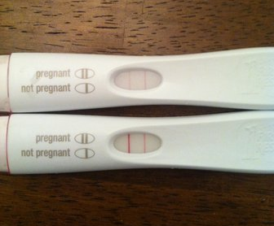

I FREAAKKED OUT!!

Slide 13


Slide 14


Slide 15
Felt Fine…I Guess?
All Tests were normal.

Slide 16
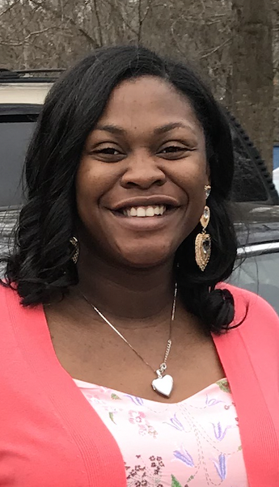
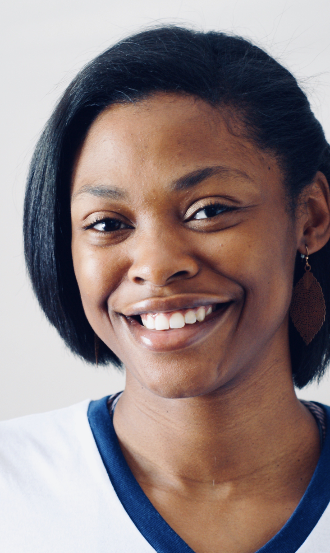
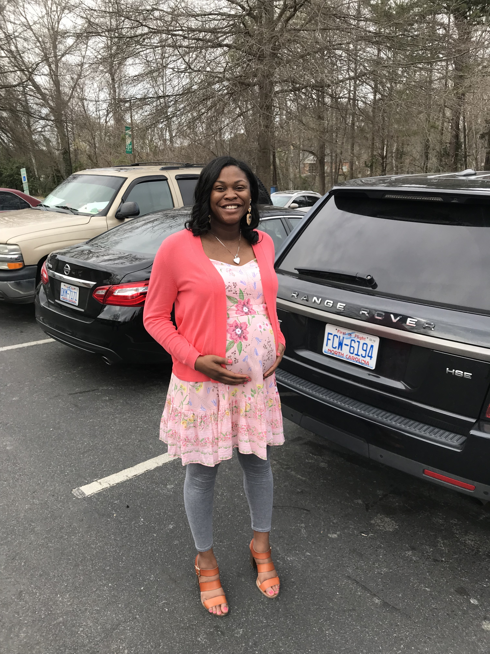

Slide 17
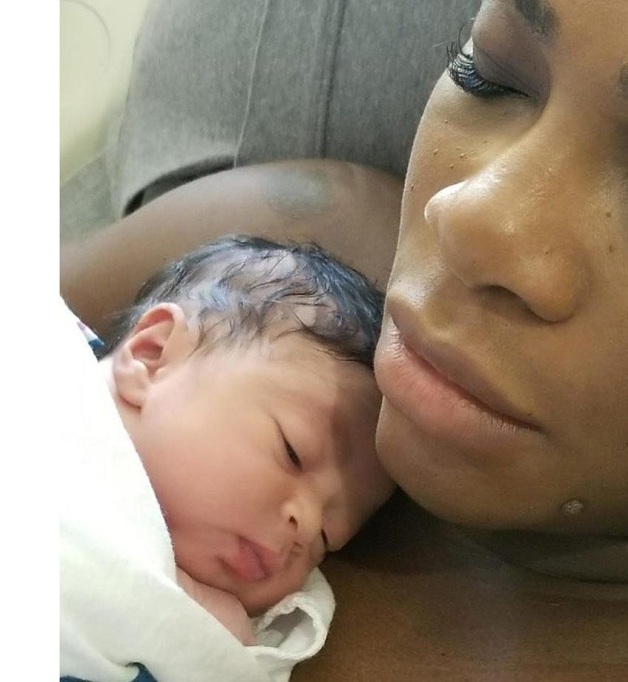
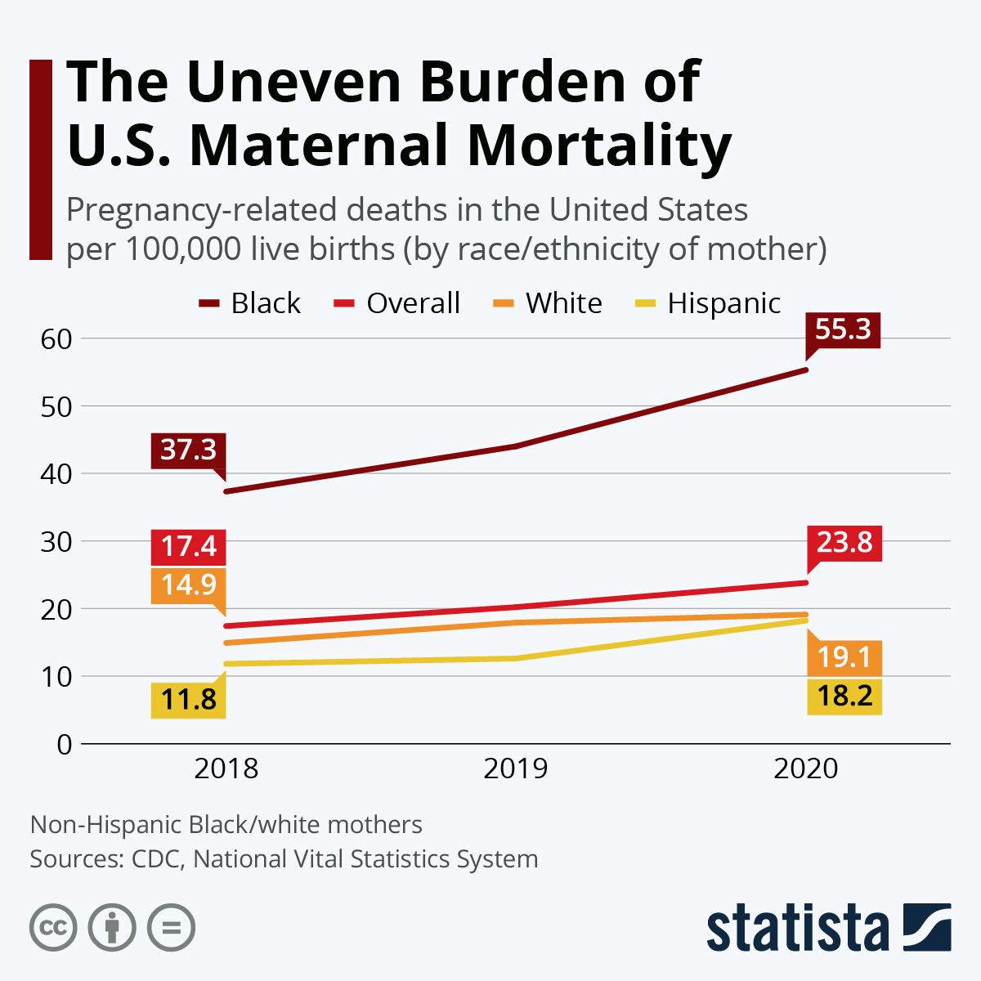

Slide 18
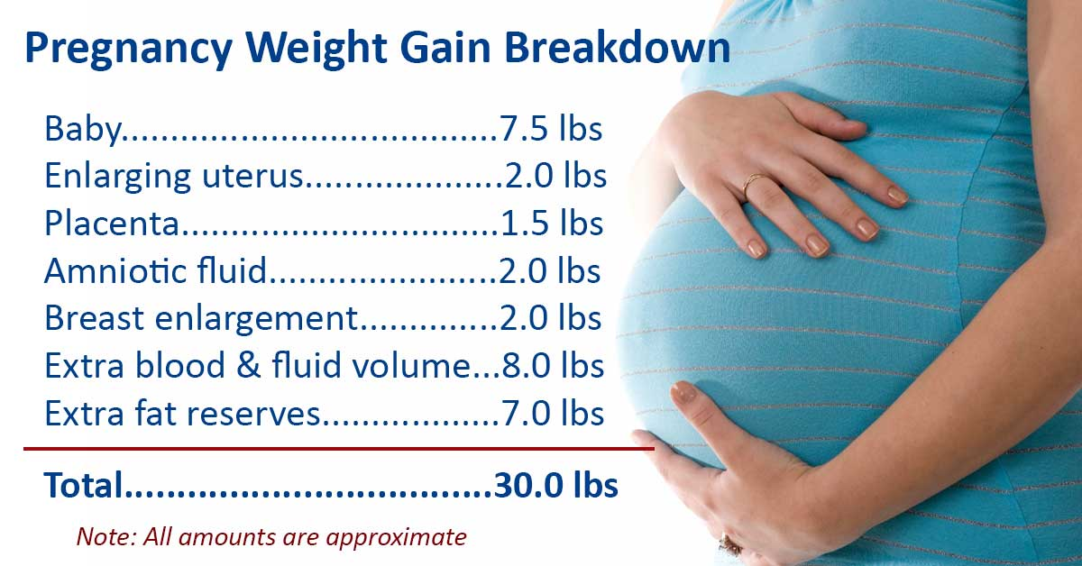

Slide 19
I had gained 87 pounds.
Notes:
135 to 222

Slide 20
After my data,
I was high risk.
Notes:
135 to 222

Slide 21


Classification Model

Slide 22
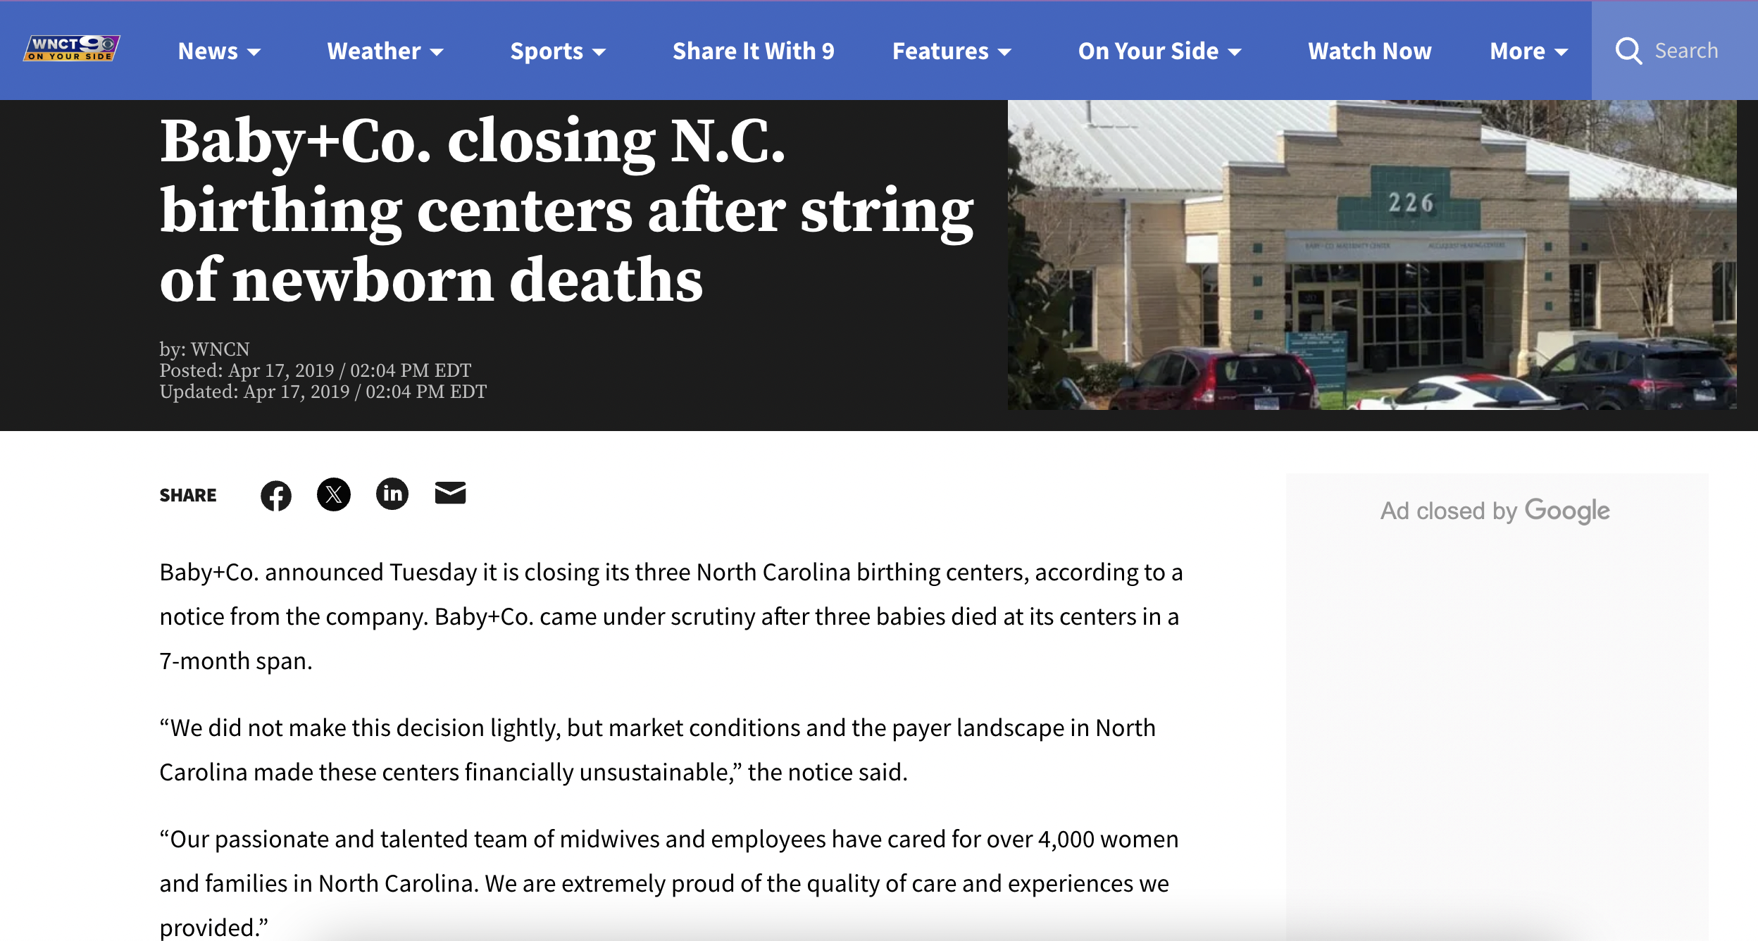

Slide 23
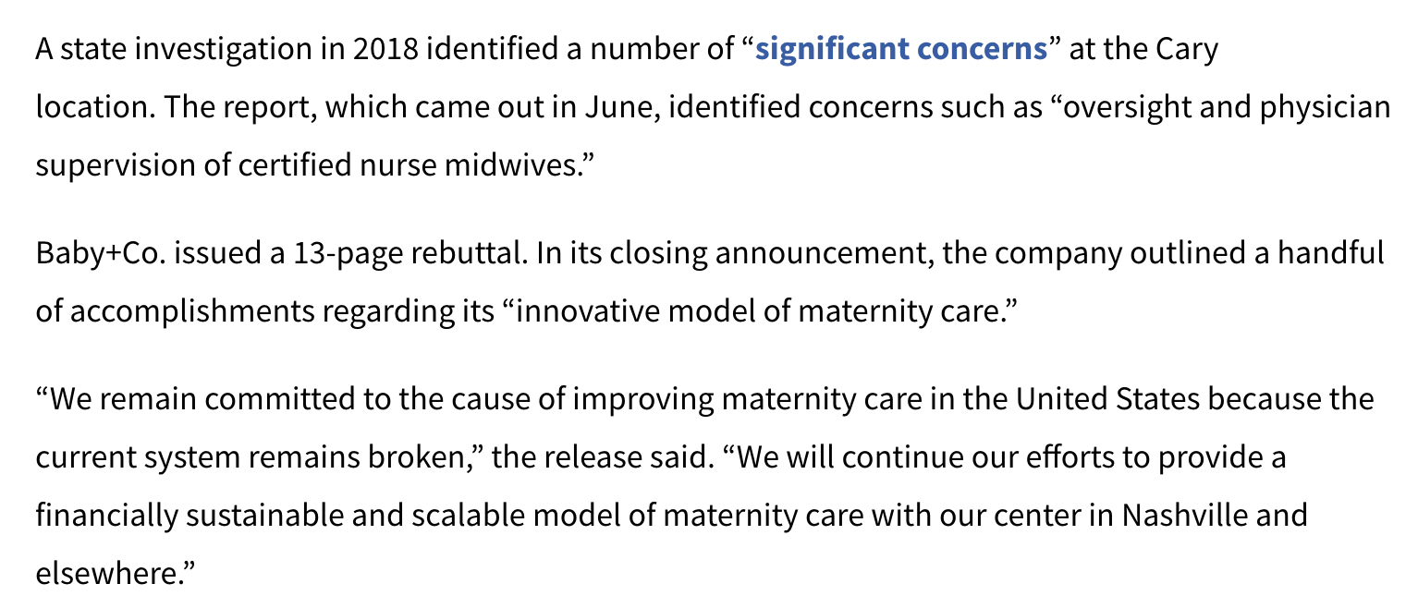

Slide 24
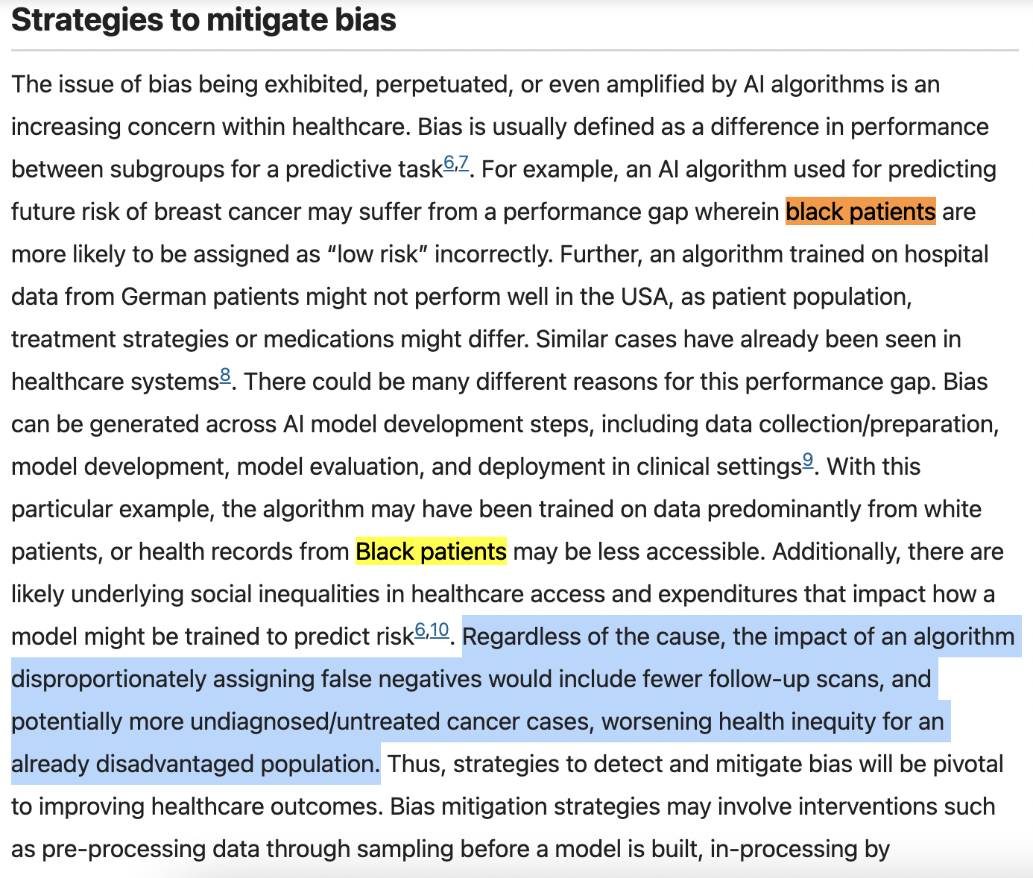
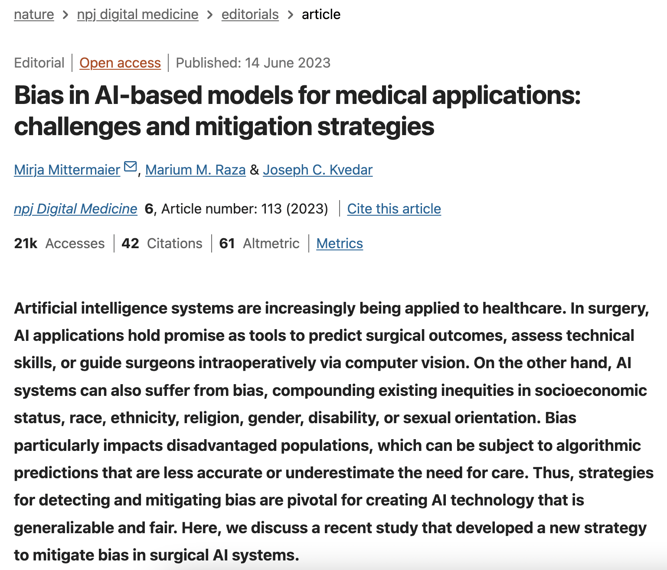

Slide 25
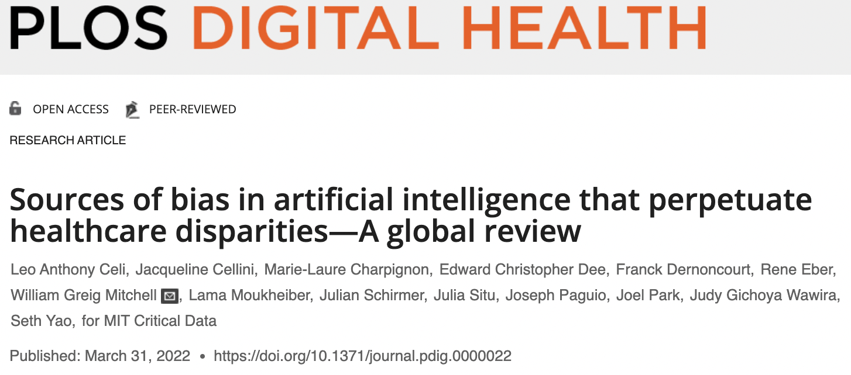
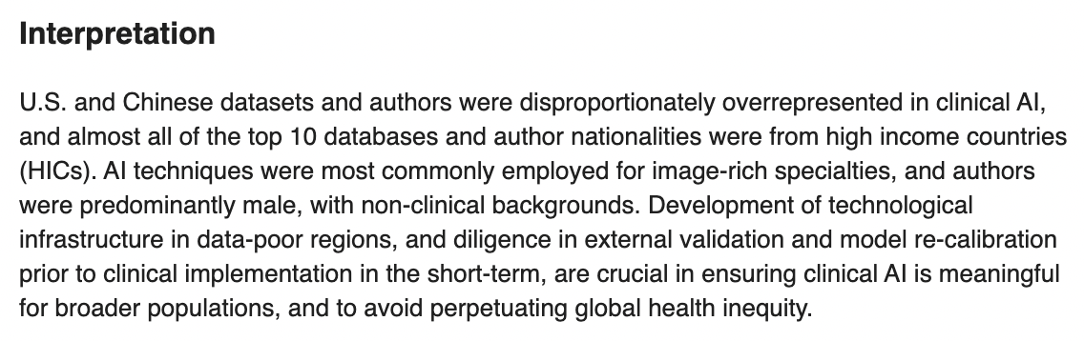

Slide 26
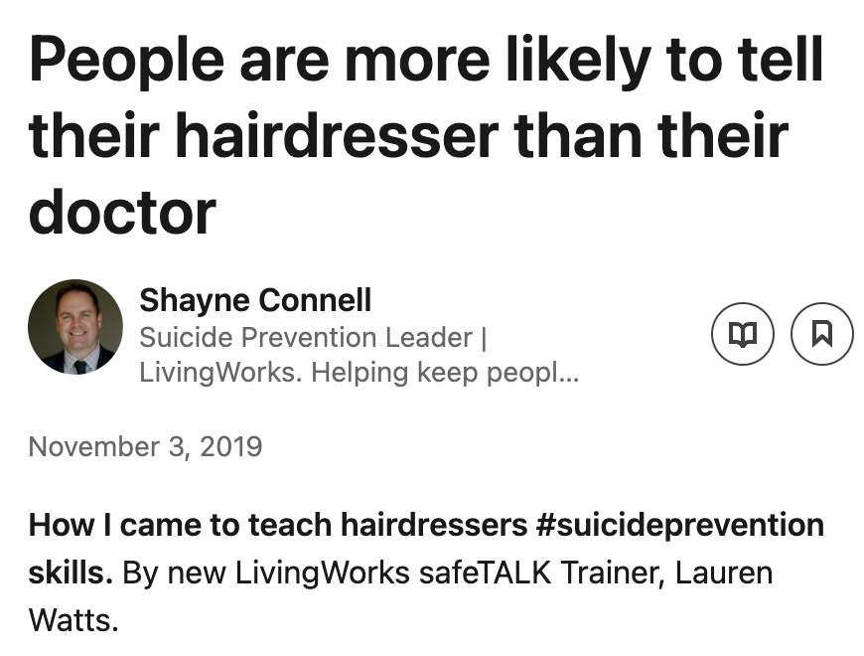

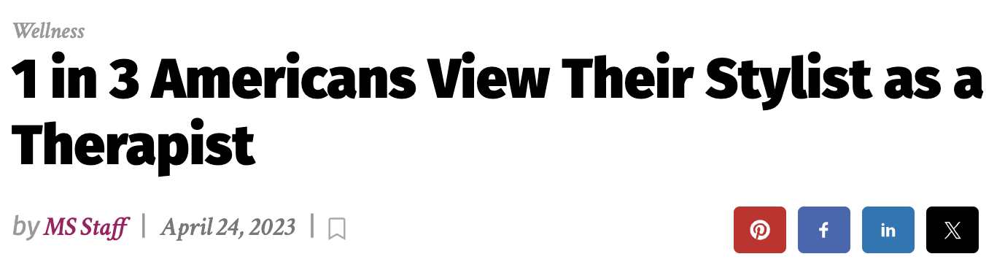
Preliminary Results
Before License
10 gestating women of color
4 weeks in final trimester
Permission was granted
Hair, Skin and Nails
Reduction in Blood Pressure and / or glucose readings
6 no longer considered high risk

Slide 27
Part 2: Considerations

Slide 29
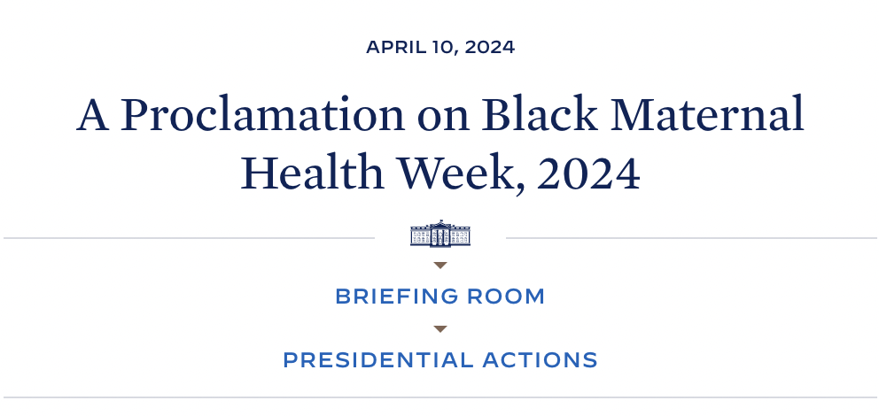
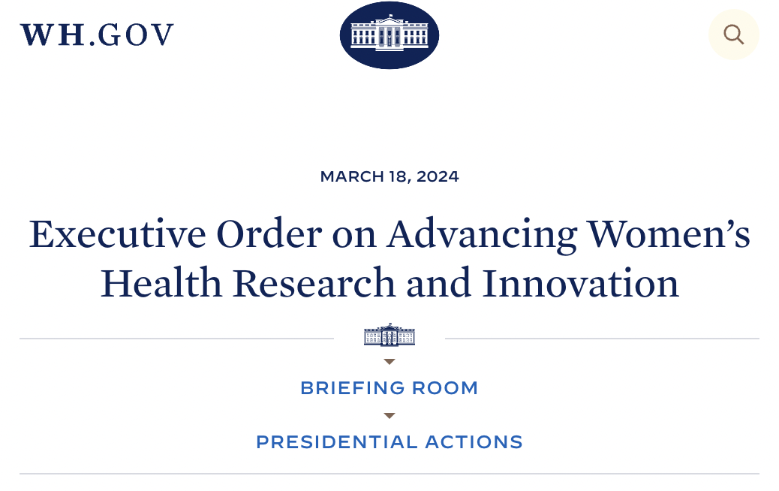
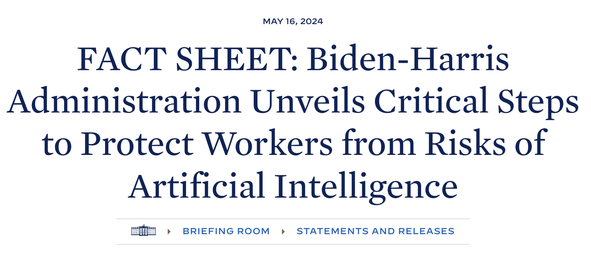
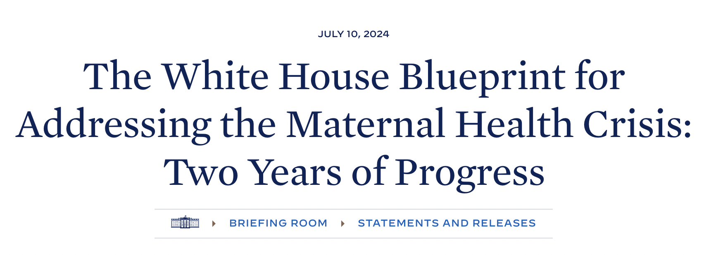

Slide 30
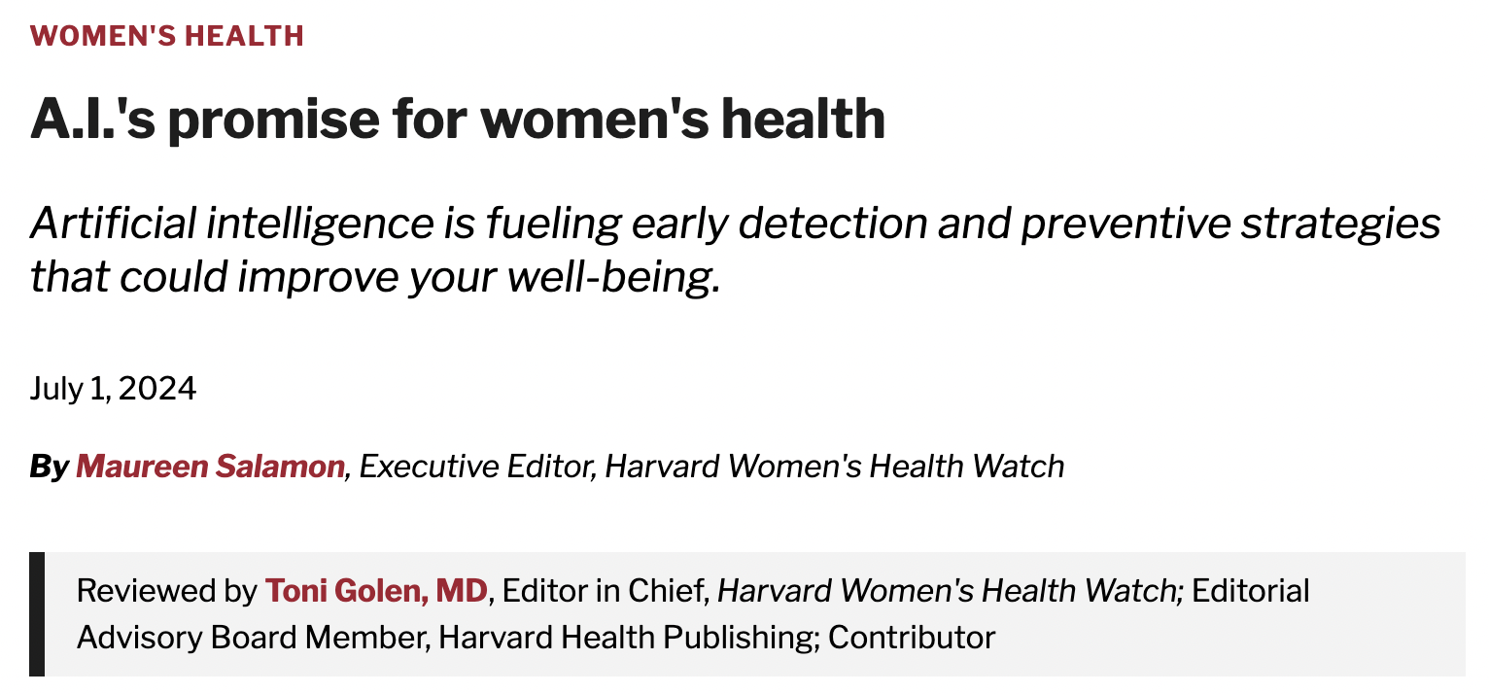
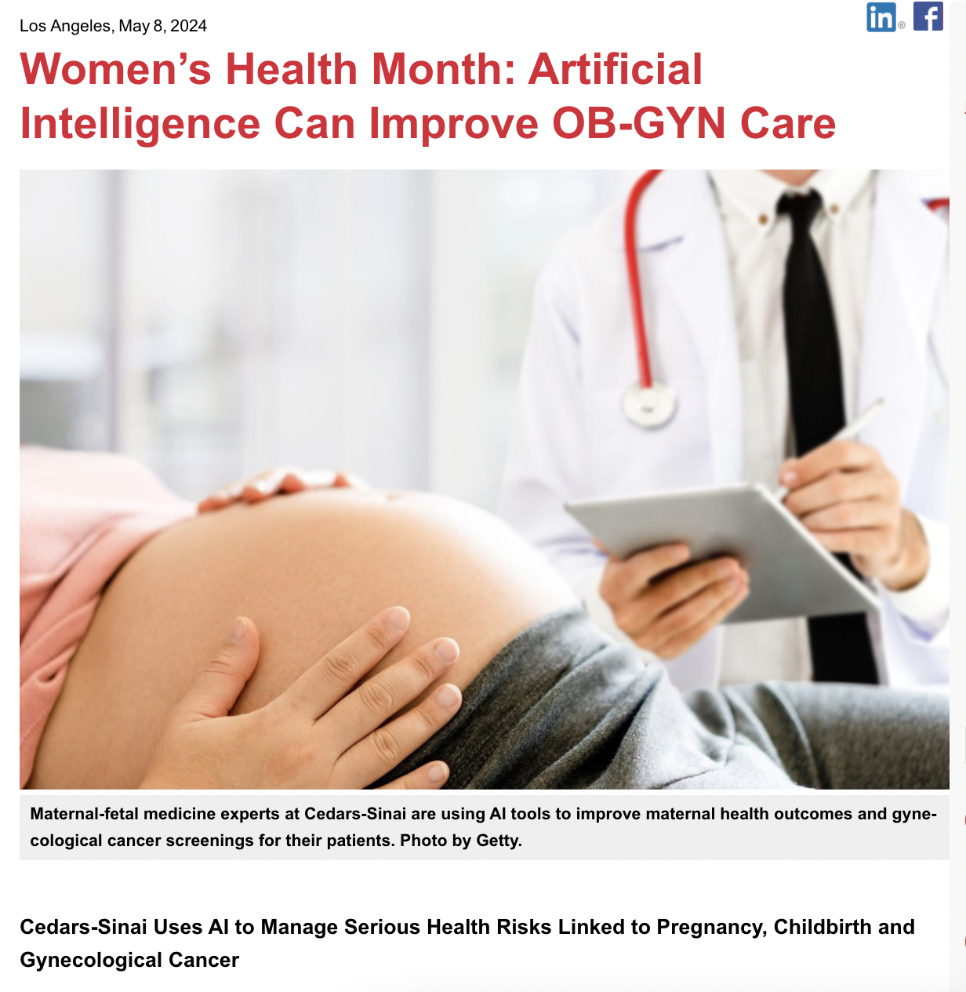
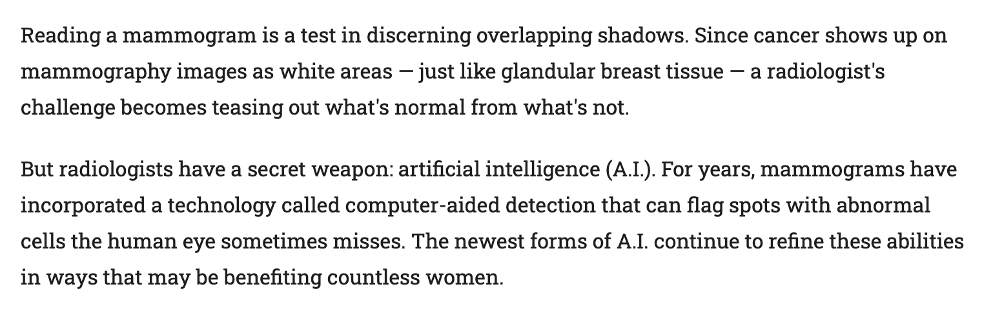
Notes:
https://www.cedars-sinai.org/newsroom/womens-health-month-artificial-intelligence-can-improve-ob-gyn-care/
https://www.health.harvard.edu/womens-health/ais-promise-for-womens-health

Slide 31


Slide 32
Part 3: Context

Slide 33
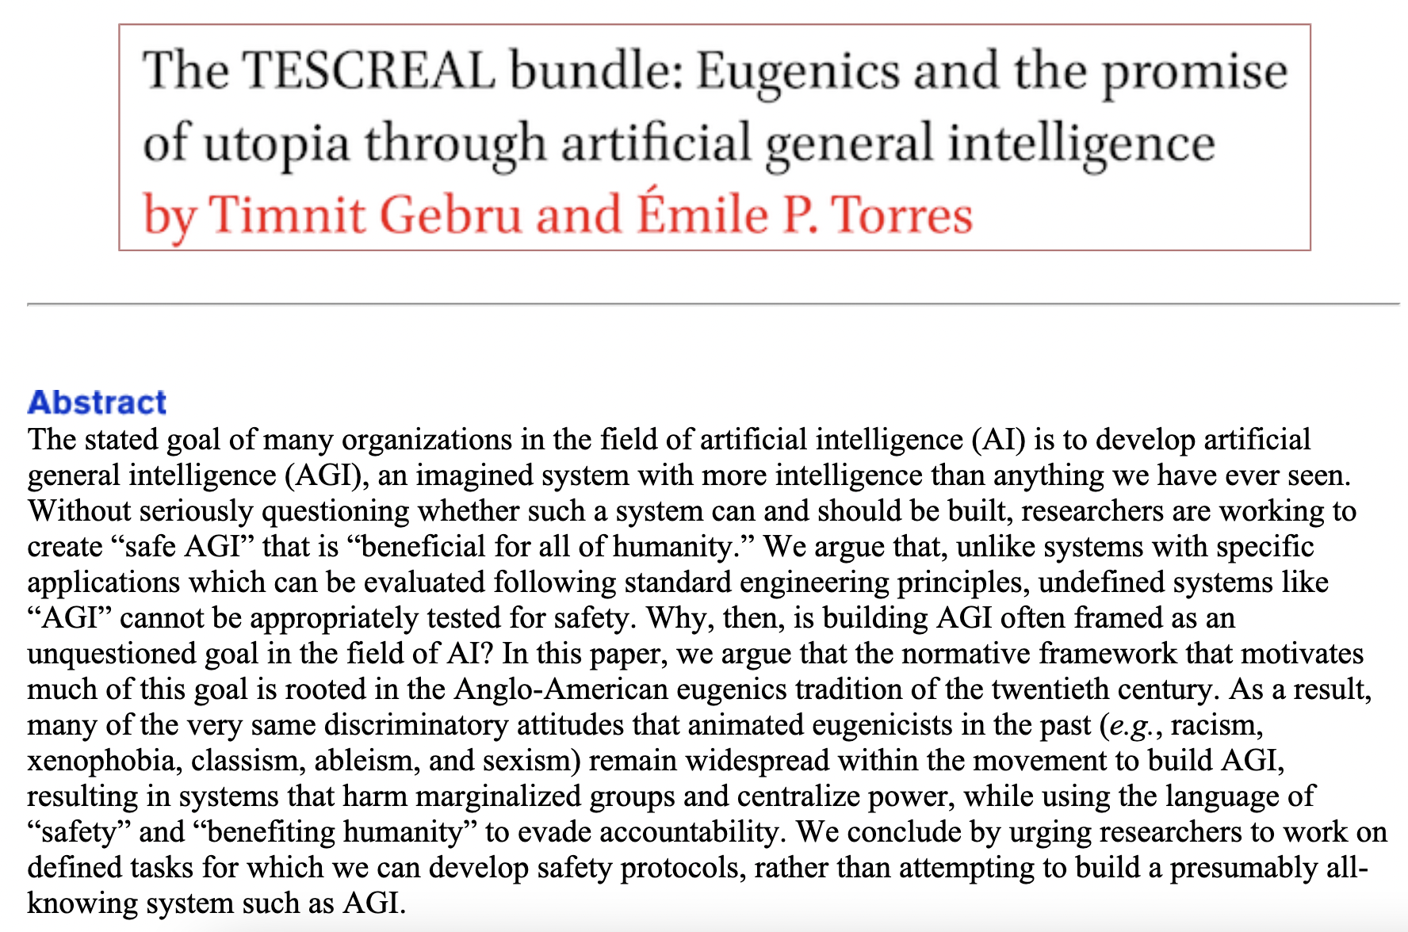
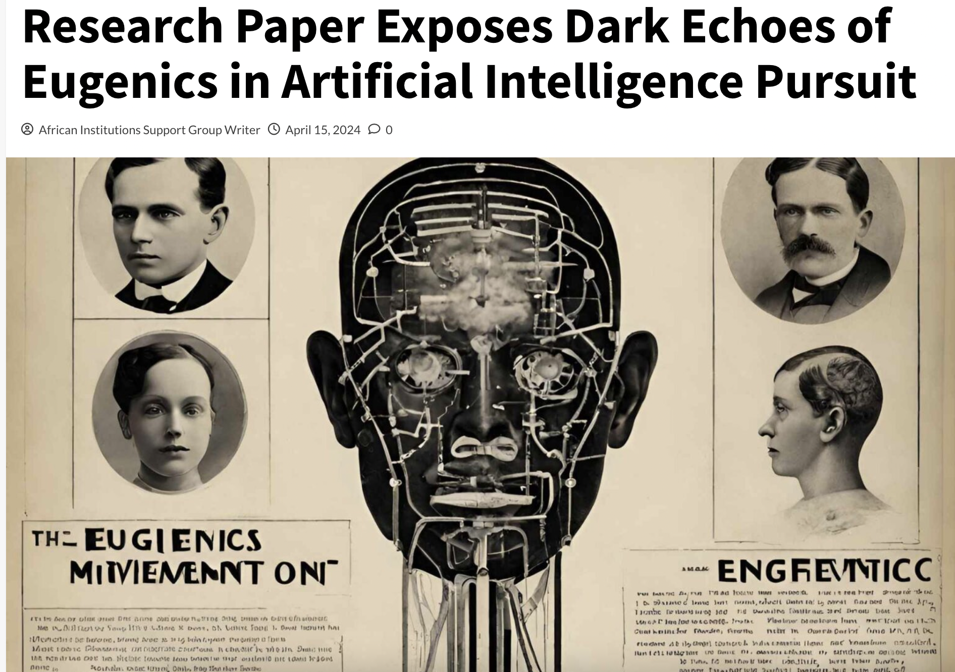

Slide 34
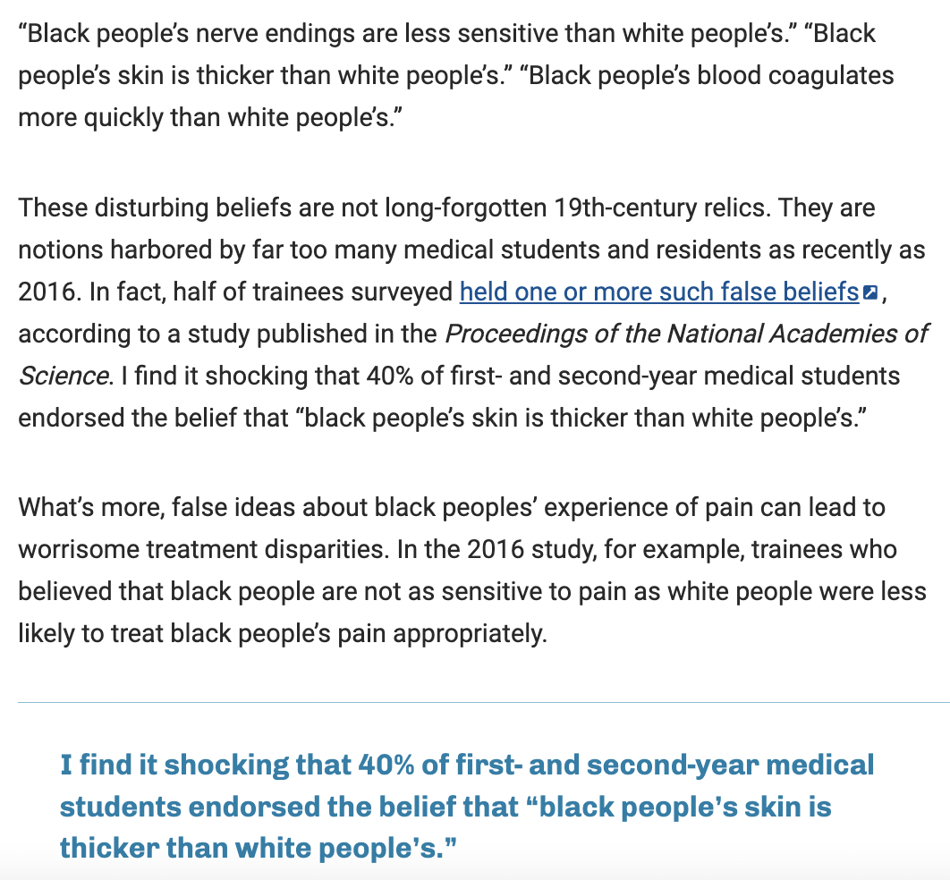

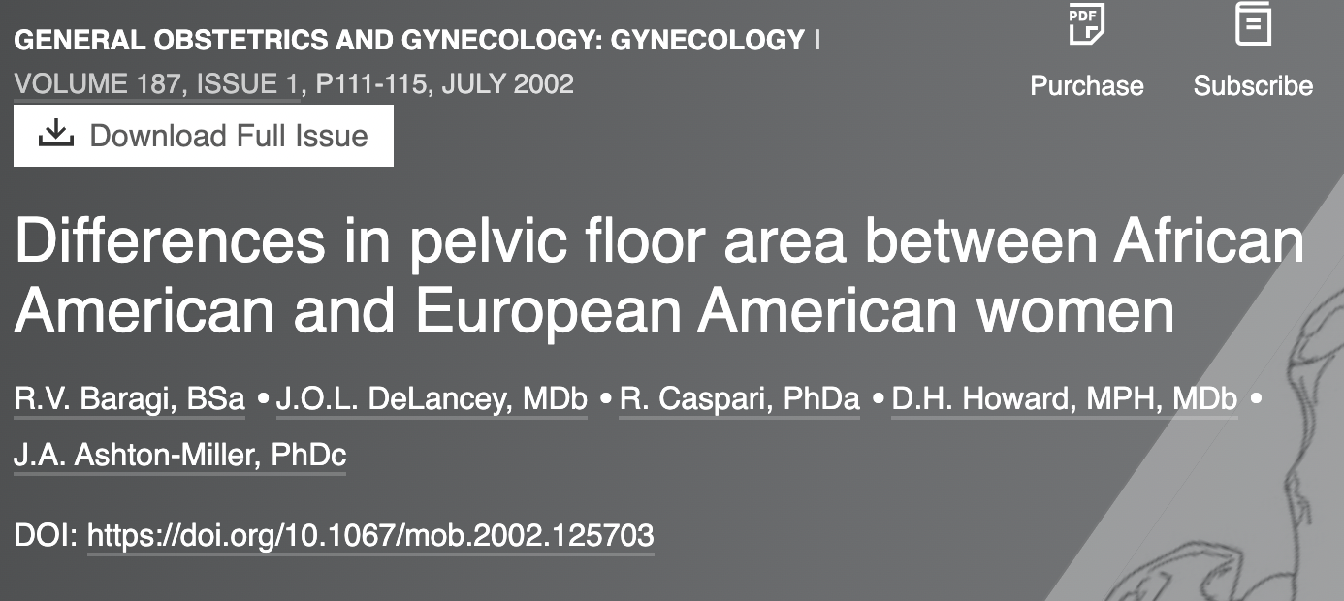
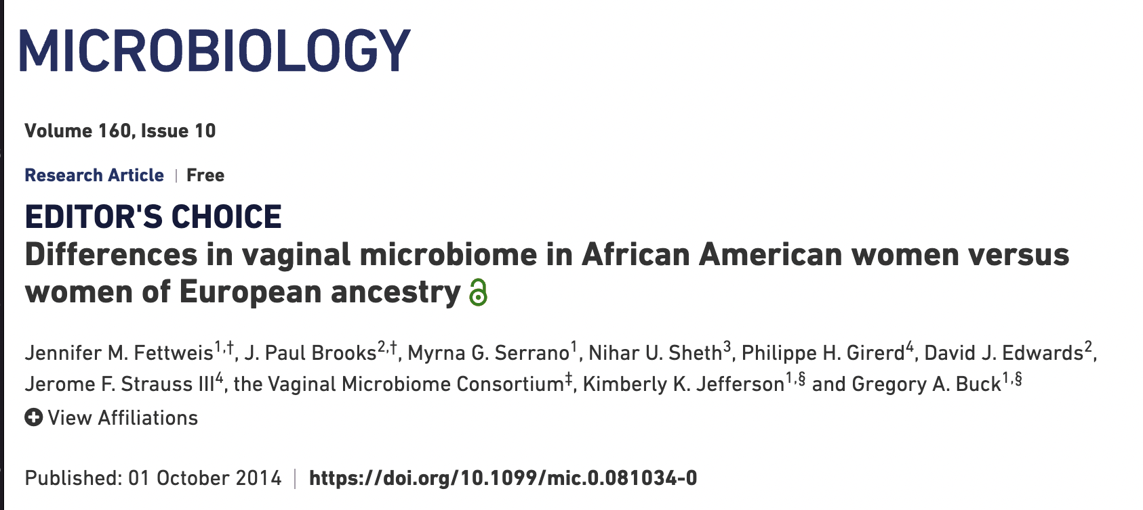
Notes:
https://www.aamc.org/news/how-we-fail-black-patients-pain

Slide 35
Women’s Health Disparities
Women spend 25% more of their lives in debilitating health than men, according to a report from the World Economic Forum and the McKinsey Health Institute.
The women's health gap includes a persistent data gap, with women being underdiagnosed for certain conditions compared to men.

Slide 36
Women’s Health Disparity Example
Women in the UK are around a third less likely to receive a coronary angiogram after a heart attack
A Lancet Regional Health Study found that women were more likely to die after being admitted to hospital with a severe heart attack, but they were also less likely to be prescribed medication to prevent future heart attacks, such as statins.
Previous research has found women were 50% more likely than men to be given an incorrect diagnosis following a heart attack

Slide 37
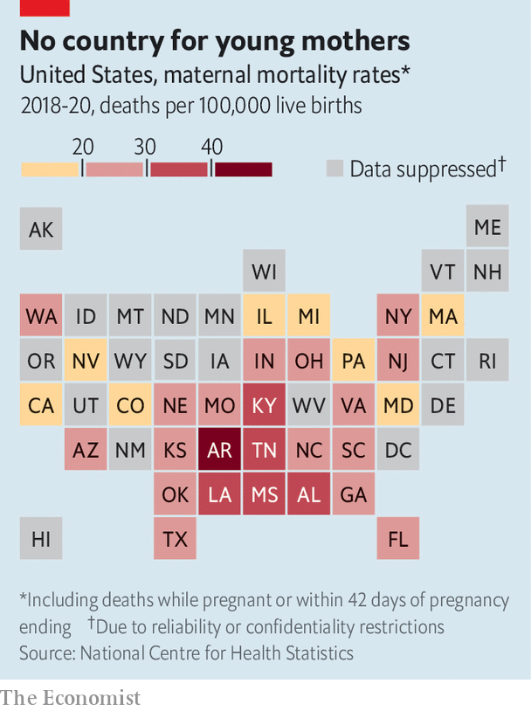
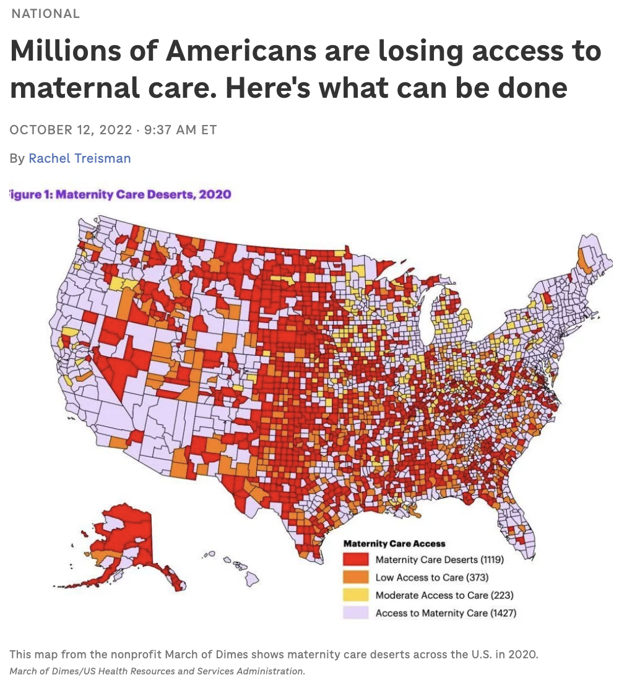

Slide 38
Part 4: In the Details

Slide 39
Preliminary Results
AI application to identifying qualifications for IVF.
Consider the sperm.
Labeling Bias
  “Adverse” can mean different things for different demographics
  Relationship Status, Family Conditions (Sickle Cell)
Historical and Systemic Biases
  Coding Systems (ex. ICD)
  Imbalanced data women more frequently mis- or underdiagnose
Success Rate: 67% to 84% when underlying data was considered.

Slide 40
Bias is in the Details
Not just about the model, how its trained, applied, etc.
The Data (regardless of modality) is a Focus.
But its not…THE FOCUS.
When it comes to health, its about the impact it will make & to whom. Patients. Clinicians.
Context is not optional.
We need patients and clinicians + along with AI specialists

Slide 41
Q&A

Slide 43
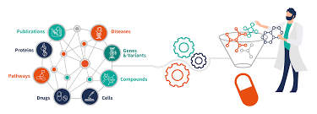
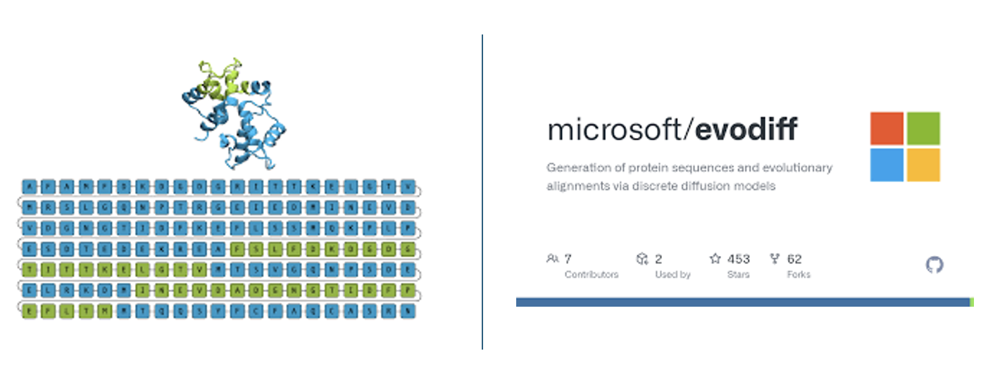

Accelerate Drug Discovery
Safeguard Against Bioweapons

Slide 44
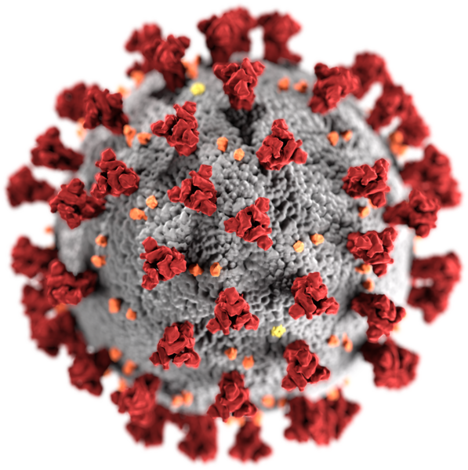


Covid-19 Pandemic

